Slide 1



Student Portfolio
STUDENT NAME:KEERTHANA K
REGISTER NO AND NMID: asunm287212401939
DEPARTMENT: BCA computer application
COLLEGE: COLLEGE/ UNIVERSITY:Madras University
1

Slide 2

Project Title
student portfolio
2

Slide 3



AGENDA
Problem Statement
Project Overview
End Users
Tools and Technologies
Portfolio design and Layout
Features and Functionality
Results and Screenshots
Conclusion
Github Link
3
3/21/2024 Annual Review

Slide 4


Problem Statement
In Today’s competitive environment,students need a platform to demonstrate their skills,creativity,and achievements beyond grades.A portfolio helps bridge this gap by providing evidence of learning and accomplishments.
4

Slide 5

Project Overview
Breif Summary Of My Project
My Portfolio contain(aboutme,projects,skills,contact
Main idea:to show my personal achievement,skills and projects
I have proceed all of my informations in this project
My project was create and usefull to know about my self
5

Slide 6

WHO ARE THE END USERS?
Student(academic,projects,resumes,bio-data).
Jod Seekers(to share with recruiters).
Freelancers(to show cilents).
Researches(to showcase publications and research).
Artists(to present creative portfolio).
Educators(to pitch ideas and business models).
6

Slide 7

TOOLS AND TECHNIQUES
HTML ->Strucutre(pages,section).
CSS ->Styling(colors,layouts,responsiveness).
JavaScript ->Interactivity(navigation menu,animations,forms validation).
Mention code editor(VS CODE)orCODEPEN and hosting platform(GitHug Pages).
Browser DevTools ->Debugging and Performance Testing.
Git&GitHub ->Version control and collaborative development.
7

Slide 8
POTFOLIO DESIGN AND LAYOUT
Section included:
Home/About Me
Projects
Skills
Contact
Responsive layout(Mobile+desktop view).
Consistent color theme and typography
8

Slide 9
FEATURES AND FUNCTIONALITY
Navigation bar with smooth scrolling.
Project showcase with images/details.
Interactive elements(hover effects,animations).
Contact form(with validation).
Responsive design for all devices.
Security measures(basic form spam protection).
Cross Browser compatibility(Chrome,Edge,Firefox,Safari).

Slide 10
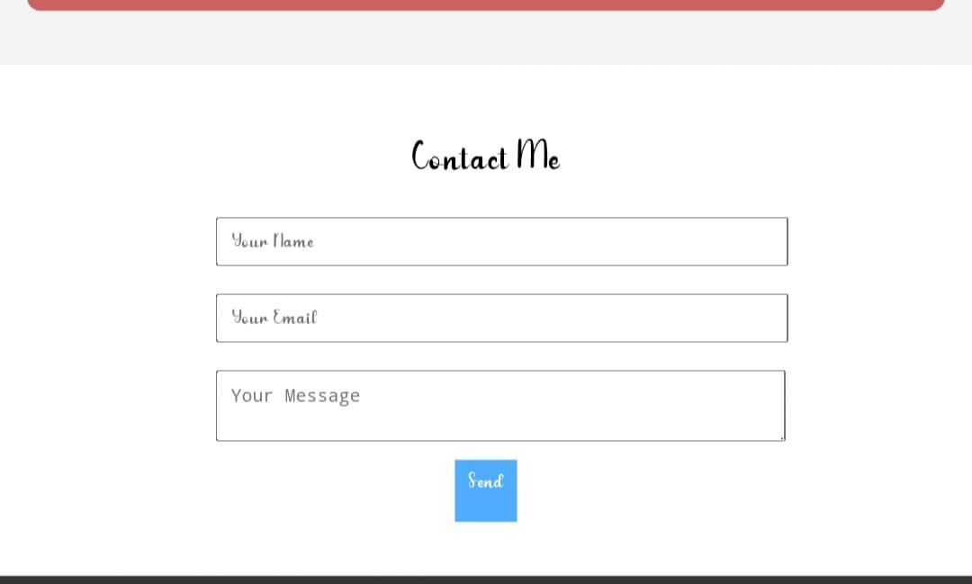
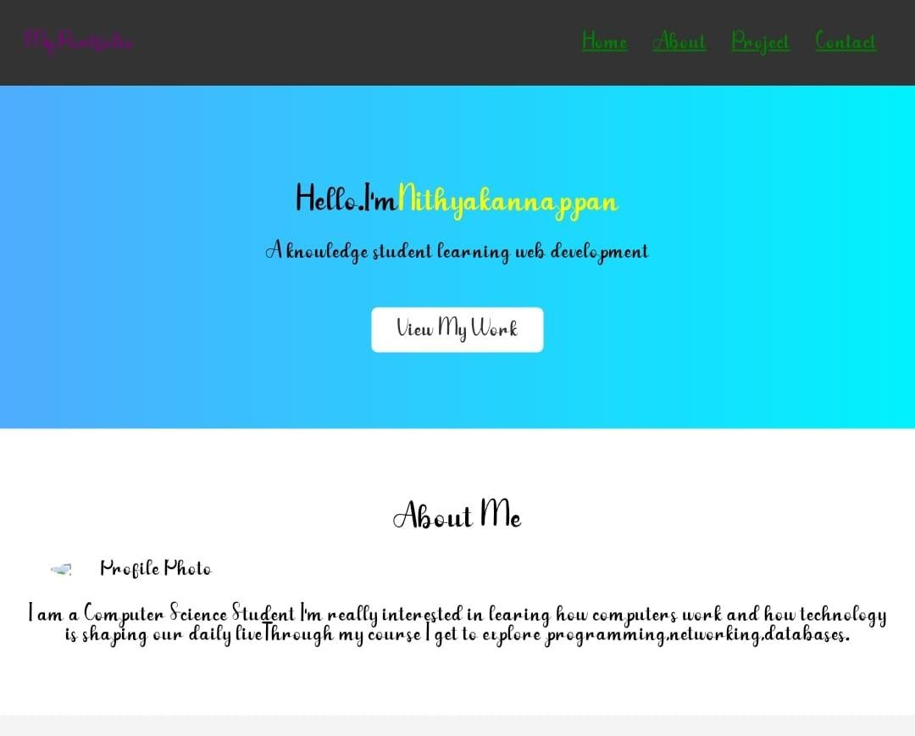

RESULTS AND SCREENSHOTS
3/21/2024 Annual Review
10

Slide 11
CONCLUSION
Highlights of My Project
Final Summary
Benefits To Society
Future Enhancement->Scope of adding new features and improvements
Personal Growth->Skills developed(technical+soft skills)
Closing Statement->Emphasis on the importance of digital portfolios in today’s world.
11

